Slide 1
RELEASE FORMS The document Assembly Line project Suffolk University Law School
- Joelle Ataya –
- Kayla Gallagher – Michael Carroll -

Slide 2
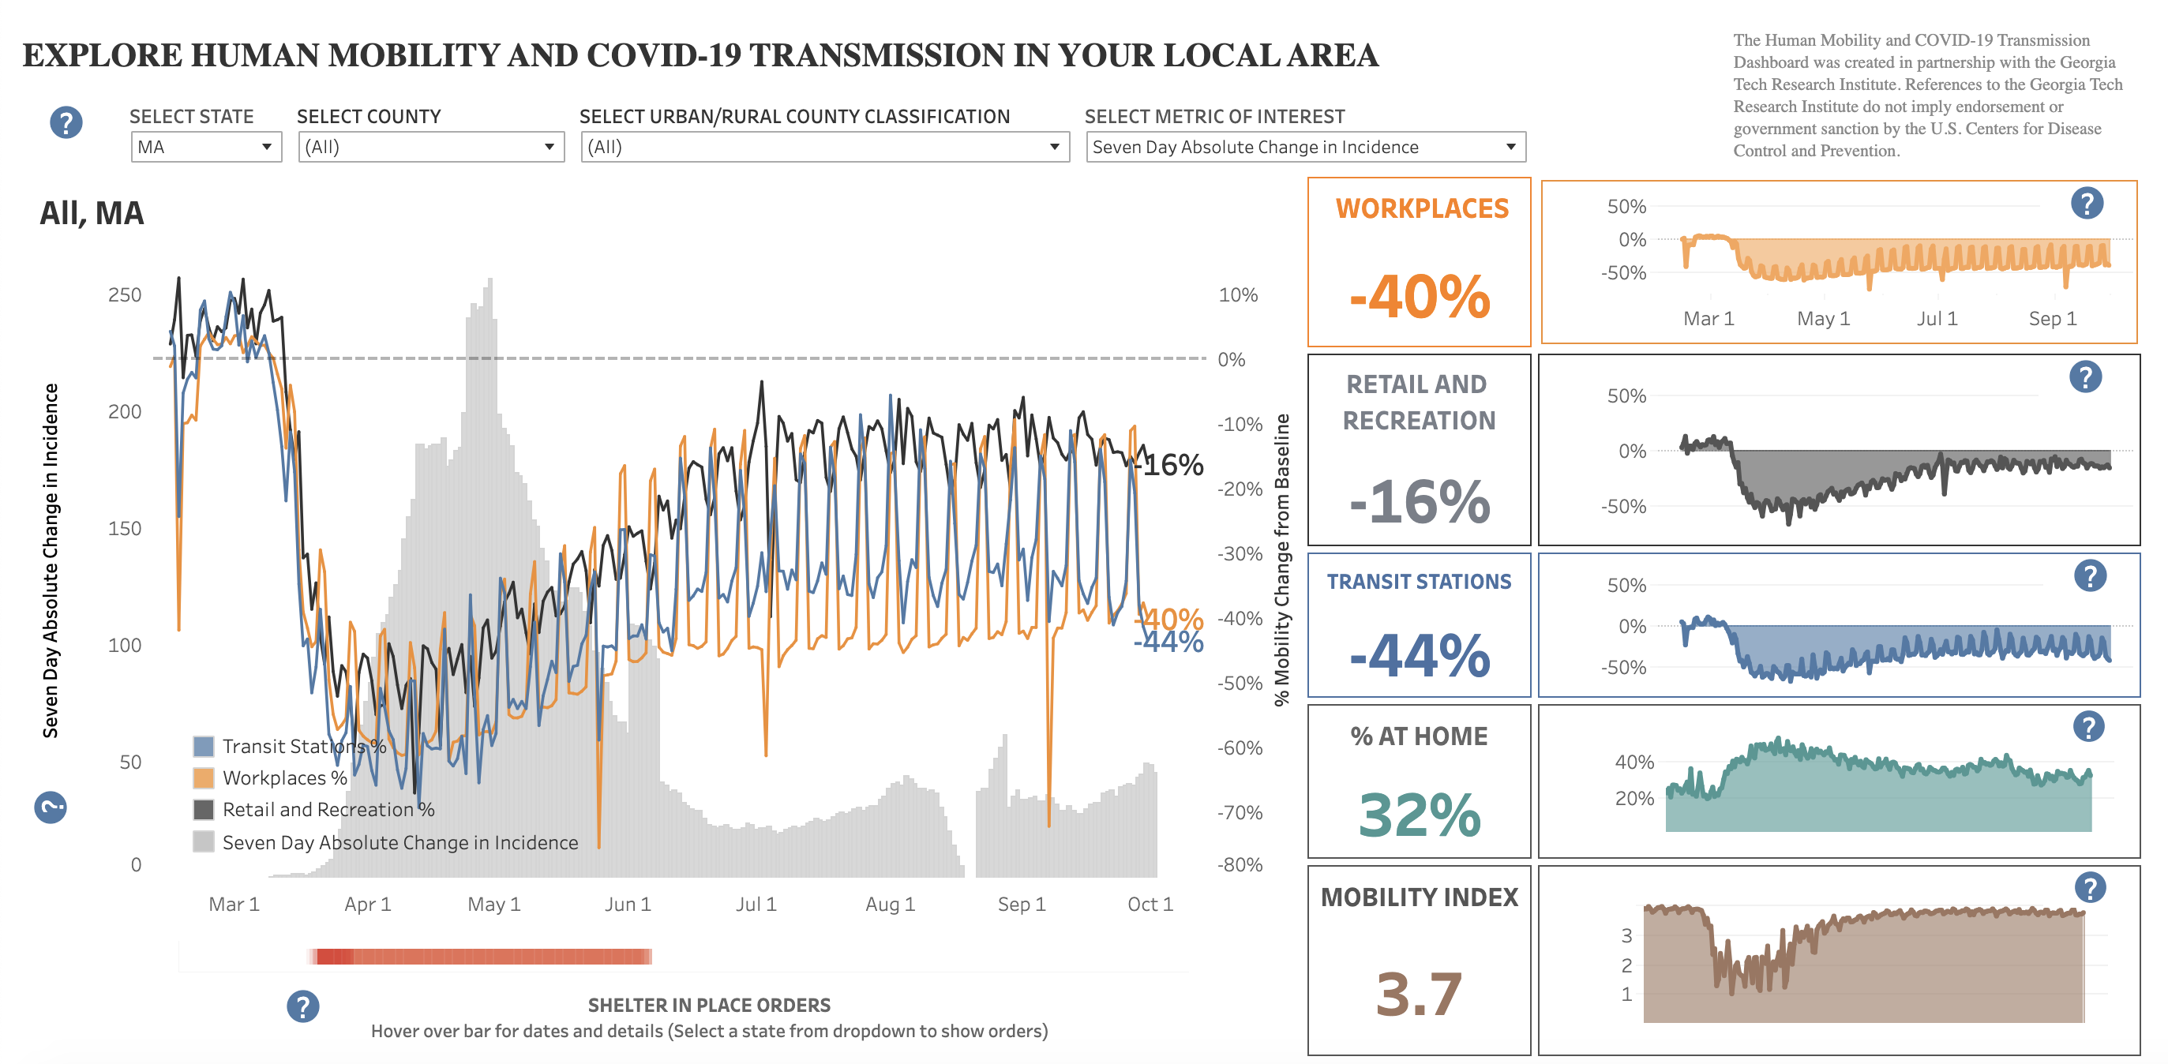
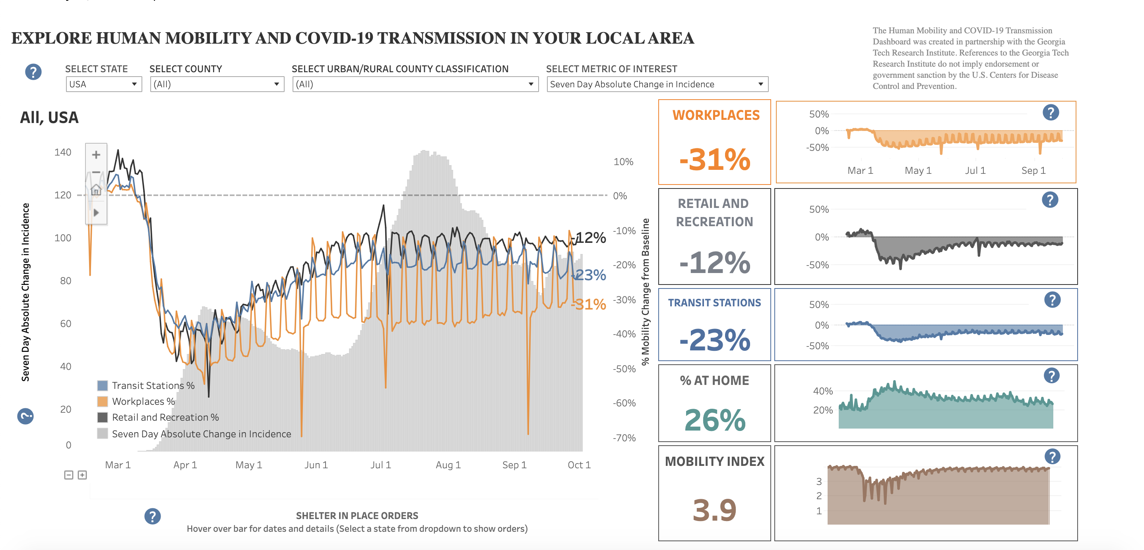
COVID-19
Really affected the world.
United States
Massachusetts
https://covid.cdc.gov/covid-data-tracker/#mobility

Slide 3
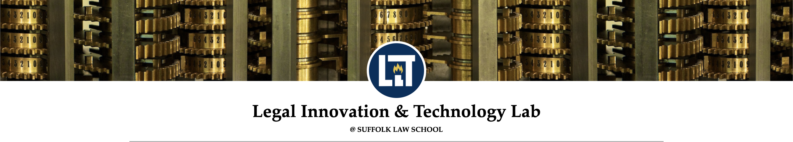
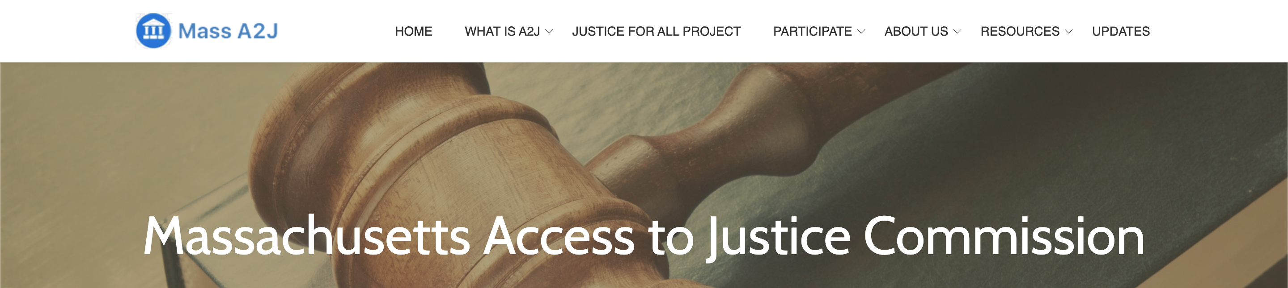
THE ASSEMBLY LINE PROJECT
https://suffolklitlab.org/doc-assembly-line/
http://www.massa2j.org/a2j/
Creating accessible versions of online court forms and pro se materials.
The forms and materials are available in multiple languages.
Focusing on addressing key areas of urgent legal need during the COVID-19 crisis.
This project will be open to the public and help them fill out forms.

Slide 4










CURRENTLY
ANY QUESTIONS?
https://www.mass.gov/
https://www.masslegalhelp.org/
https://www.masslegalservices.org/
https://www.lexisnexis.com/
https://www.google.com/
-
-
-
PROBLEM
redo
Images provided by: Microsoft PowerPoint Stock Images

Slide 5







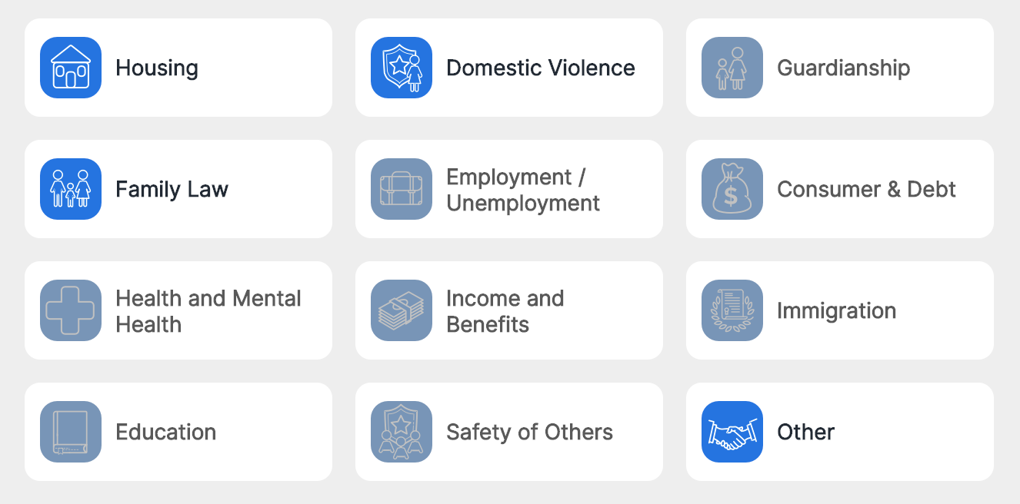



WHAT WE PLAN TO DO
The Assembly Line Project wants to simplify this whole process.
How it is now
Provides forms for MA court filings
Images provided by: Microsoft PowerPoint Stock Images
https://massaccess.suffolklitlab.org/

Slide 6
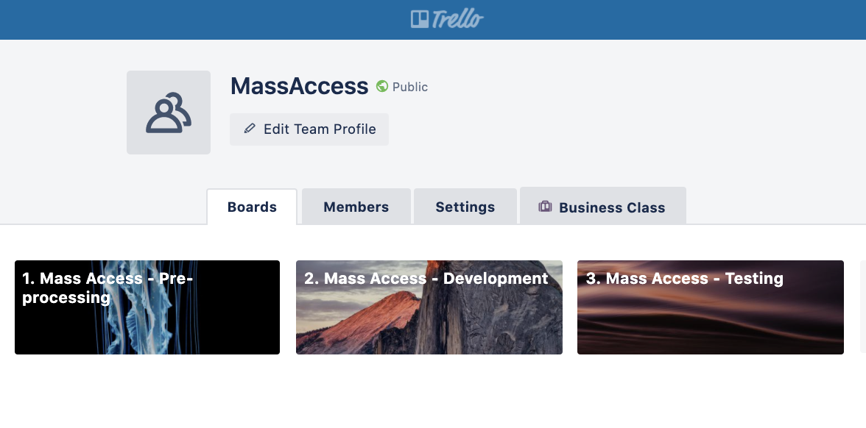


TRELLO
Trello, a collaborative platform, to work on the forms.
Trello → step-by-step checklist to generate a form.
+ helpful tips and links.
https://trello.com/massaccess
A2J Assembly Line and Docassemble slack channels → ask questions + get help.
https://slack.com/
https://slack.com/

Slide 7
MY GROUP GOALS
BHA Release Form - ENGLISH
General Release Form - ENGLISH
General Release Form - SPANISH
https://www.bostonhousing.org/BHA/media/Documents/Applicants/Application%20Documents/Authorize-to-release2015.pdf
https://www.masslegalservices.org/content/client-authorization-release-information

Slide 8
☺
Images provided by: Microsoft PowerPoint Stock Images

